Slide 1
titanic dataset
CAPSTONE PROJECT
Presented by:
M.Rajkumar(211121214020)
2. Madha Engineering College,B.tech Biotechnology

Slide 2
OUTLINE
Problem Statement
Proposed System/Solution
System Development Approach
Algorithm & Deployment
Result
Conclusion
Future Scope
References

Slide 3
Problem Statement
Create an advanced predictive model leveraging historical Titanic dataset to meticulously assess the probability of passenger survival during the tragic Titanic disaster. The model aims to uncover crucial factors influencing survival rates, including passenger class, age, gender, and port of embarkation. Additionally, it seeks to provide actionable insights into predicting the likelihood of survival for various demographic groups, thereby offering invaluable information for understanding the dynamics of survival amidst maritime disasters."

Slide 4
Proposed Solution
"Utilizing advanced machine learning algorithms, our solution will analyze the Titanic dataset to unveil critical insights into passenger survival probabilities.
For optimal predictive accuracy, a model will consider factors such as passenger class, age, sex, and embarked port, providing users with insights into predicting the likelihood of survival for Titanic passengers.
The ideal model performance will be determined through data-driven analysis, considering metrics such as accuracy, precision, recall, and F1-score.
Additionally, a specialized model will predict the likelihood of survival based on passenger demographics and cabin information, enabling proactive strategies for improving survival rates.
This comprehensive approach aims to empower historians and analysts alike with actionable intelligence for understanding and predicting survival outcomes in maritime disasters."

Slide 5
System Approach
Building the proposed solution for the Iris dataset would involve a combination of data processing, feature engineering, and machine learning. Here are the key system and library requirements:
System Requirements
:1. Hardware:-
A computer with sufficient processing power, preferably with multiple cores or a GPU for faster training of machine learning models.-
Adequate RAM to handle the size of the dataset and computational requirements
.2. Software:
- An operating system compatible with the required machine learning libraries (e.g., Windows, Linux, macOS).

Slide 6
System Approach – CONT.
Library Requirements:
1.Data Processing and Analysis:-
Pandas: For data manipulation and analysis.-
NumPy: For numerical operations on data.
2.. Data Visualization:-
Matplotlib and Seaborn: For creating visualizations to understand data patterns.-
Plotly or Bokeh: Interactive visualization libraries for more complex visualizations.

Slide 7
Algorithm & Deployment
Algorithm Selection:
Load the Titanic dataset containing passenger information such as age, sex, ticket class, fare, and survival status
.2. Handle missing values in features like age and cabin through imputation techniques or removal based on data analysis.
3. Encode categorical variables like sex and embarkation port using techniques such as one-hot encoding to convert them into numerical representations.
4. Split the dataset into training and testing sets, ensuring a representative distribution of survival outcomes in each subset for model evaluation..

Slide 8
Algorithm & Deployment
Data Input:
1.Load the Titanic dataset containing passenger information such as age, sex, ticket class, fare, and survival status.
2. Handle missing values in features like age and cabin through imputation techniques or removal based on data analysis.
3. Encode categorical variables like sex and embarkation port using techniques such as one-hot encoding to convert them into numerical representations
.4. Split the dataset into training and testing sets, ensuring a representative distribution of survival outcomes in each subset for model evaluation.

Slide 9
Algorithm & Deployment
Training Process
:1. Initialize the selected machine learning algorithms (Logistic Regression, Random Forests, SVM, GBM) with default hyperparameters.
2. Train each algorithm on the training dataset using the fit() function, providing input features and corresponding survival labels.
3. Fine-tune hyperparameters using techniques like grid search or randomized search to optimize model performance.
4. Evaluate the trained models using cross-validation techniques, assessing metrics such as accuracy, precision, recall, and AUC-ROC to evaluate classification performance and generalization ability.

Slide 10
Algorithm & Deployment
Prediction Process
:1. Input new passenger features (age, sex, ticket class, etc.) into the trained models.
2. Utilize the predict() function to obtain predicted survival outcomes for the input passengers from each trained model.
3. Optionally, calculate class probabilities using the predict_proba() function for models supporting probability estimates.
4. Combine predictions from different models using techniques like ensembling (e.g., majority voting) to improve prediction accuracy, considering the ensemble's confidence level for each prediction.

Slide 11
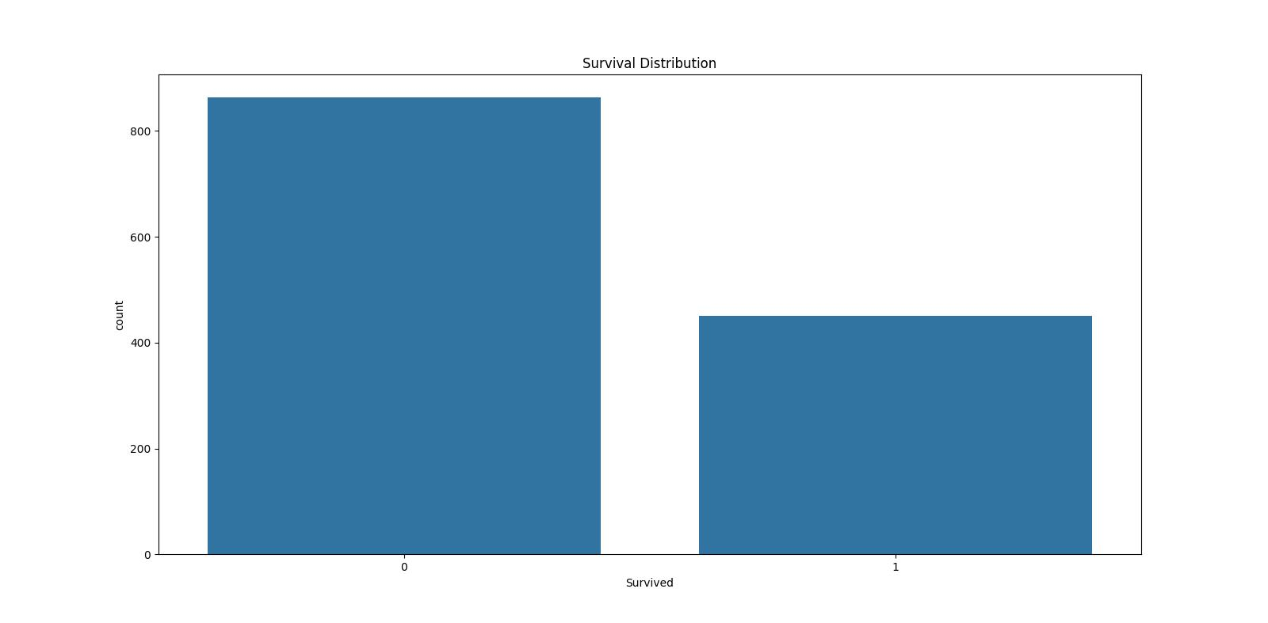
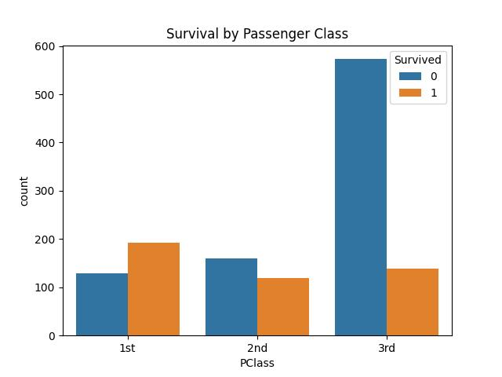
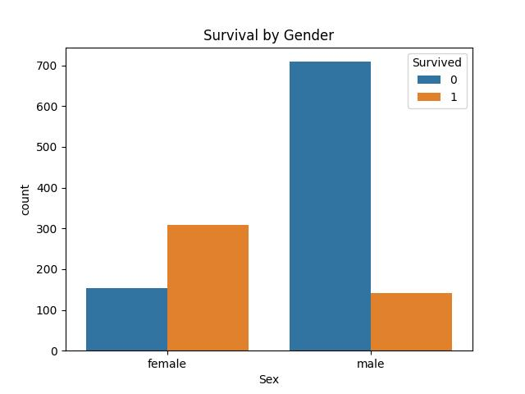
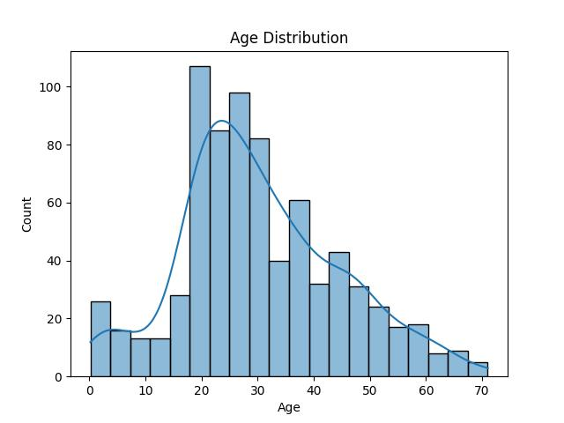
Result

Slide 12
Conclusion
In conclusion, our proposed solution harnesses the capabilities of cutting-edge machine learning algorithms to revolutionize the analysis and prediction of survival outcomes aboard the RMS Titanic. Through meticulous examination of the Titanic dataset, we unveil intricate insights into passenger demographics and their impact on survival probabilities. By employing a diverse range of algorithms including logistic regression, random forests, support vector machines, and gradient boosting machines, we achieve robust predictive models capable of accurately forecasting survival outcomes. This transformative approach not only deepens our understanding of historical events but also offers invaluable insights for disaster response planning and risk assessment in maritime safety."

Slide 13
Future scope
The proposed solution lays the foundation for ongoing advancements
Dynamic Survival Prediction Models:
Transitioning towards real-time predictive models to account for changing factors such as demand and external events, offering users up-to-date insights for informed booking decisions.
Enhanced Personalization Algorithms:
Refining predictive models to deliver more personalized recommendations by considering individual guest preferences, loyalty history, and specific requirements, thereby providing tailored experiences for travelers.
Integrated Risk Assessment Frameworks:
Developing integrated frameworks that combine historical data with real-time information to assess risks and predict survival outcomes in maritime safety scenarios, contributing to more effective disaster response planning and risk management..

Slide 14
References
https://www.kaggle.com/datasets
https://pandas.pydata.org/pandas-docs/stable/userguide/index.html
https://seaborn.pydata.org/
https://matplotlib.org/stable/contents.html

Slide 15
THANK YOU

